Slide 1
EVENT HALL BOOKING SYSTEM
SELF-STUDY REVIEW
H Anarghya (1BM17IS028)
Pannaga Sharma M L (1BM17IS053)

Slide 2
ABSTRACT
In this application customer can view different types of halls based on their requirement and send an enquiry if they are interested to book that hall and admin can view the booking schedules of their respective halls & and are responsible to confirm or reject that booking.

Slide 3
FUNCTIONAL REQUIREMENTS
The user is able to view different categories of halls and for each hall, the user can view all the details such as name, address, contact details of admin, seating capacity, and the rent per day.
User is able to search for the required hall based on the location, budget and the capacity of the hall.
User is able to select any hall and can send an enquiry for the same by filling their contact details and the date and time according to their requirements.
User can pay the advance amount after their booking has been confirmed.
Admin of a hall can view all the enquiries for their hall(s) and accept/reject the booking.
Admin can edit the details of the halls and save the same into the database.
Admin can view the details of all the bookings that have been confirmed for their hall(s).

Slide 4
NON-FUNCTIONAL REQUIREMENTS
Performance
Reliability
Usability
Compatibility

Slide 5
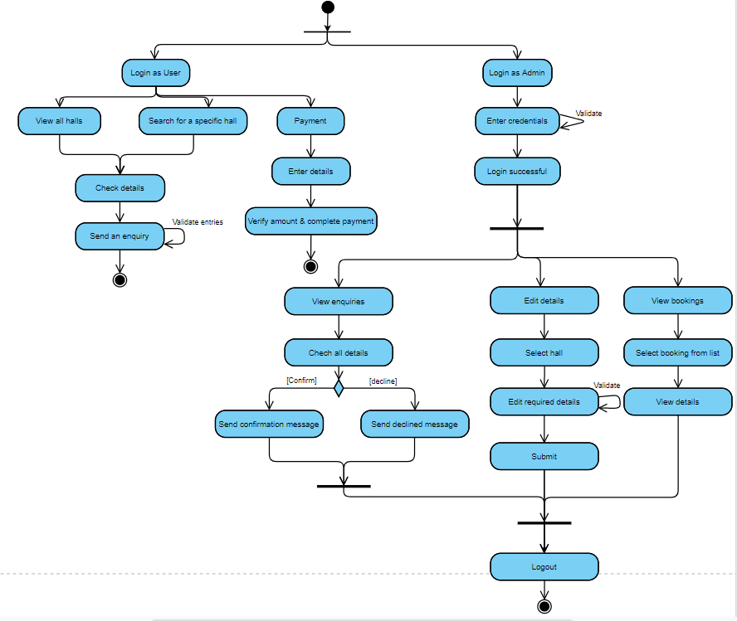
FLOW OF CONTROL

Slide 6
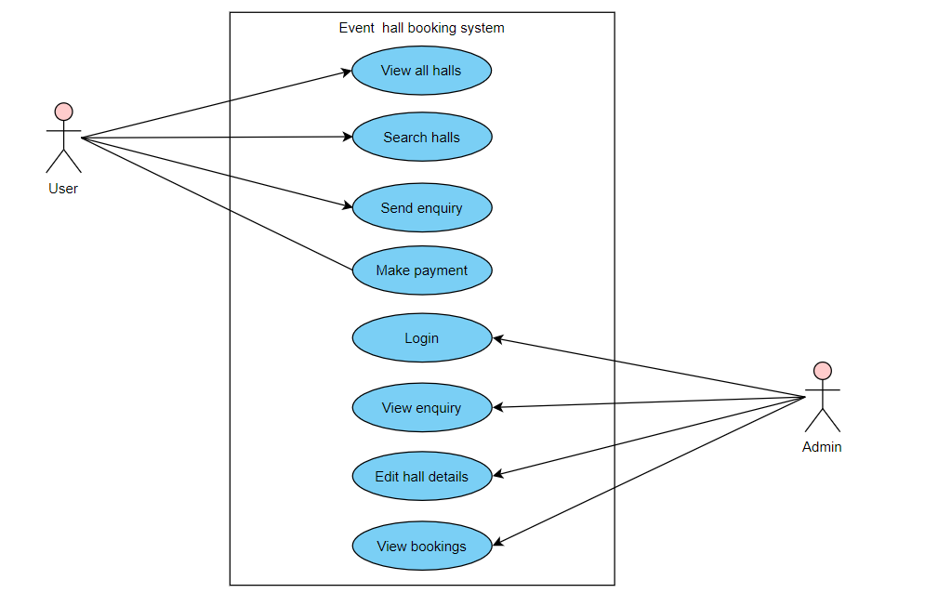
Use-case diagram

Slide 7
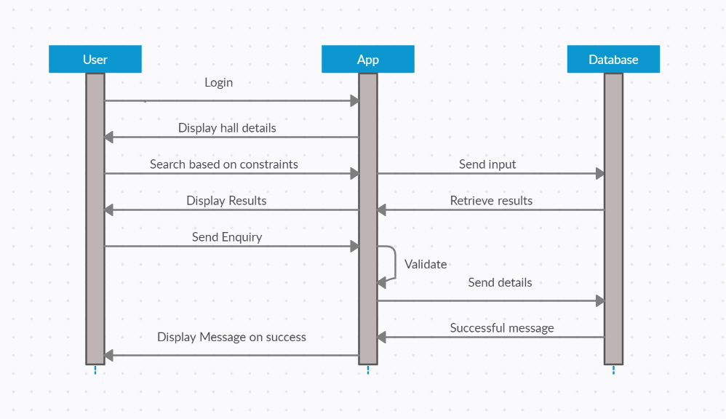
Sequence diagram

Slide 8
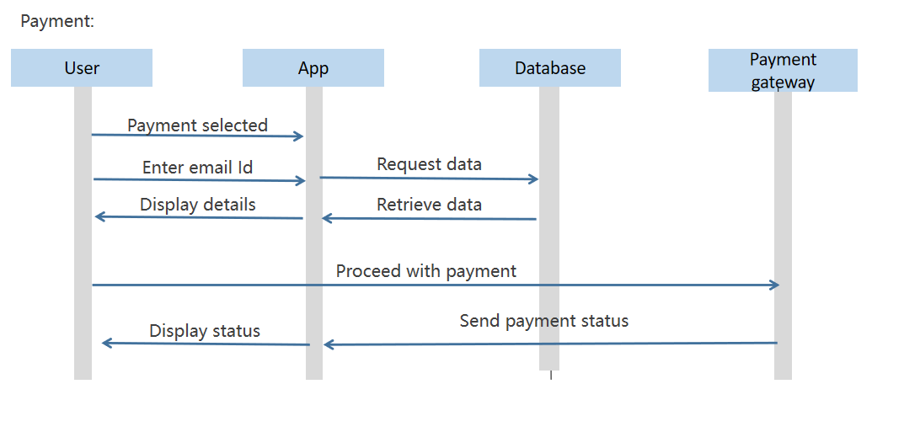
Sequence diagram

Slide 9
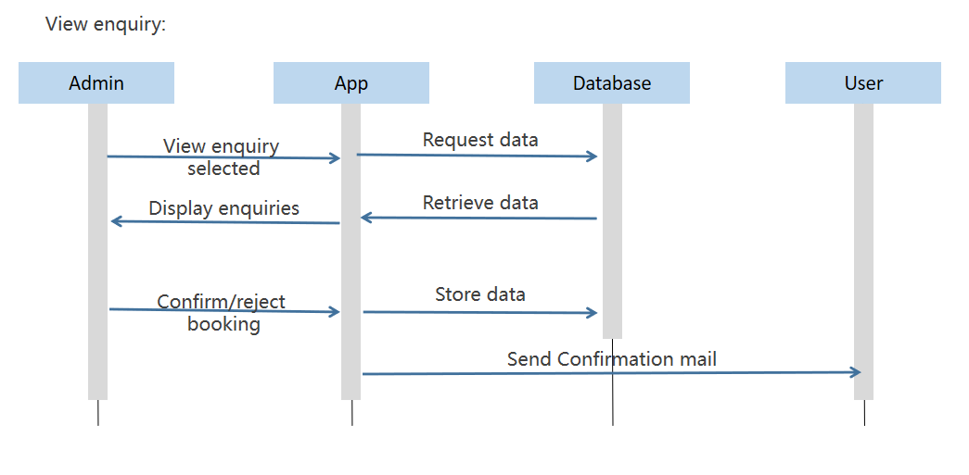
Sequence diagram

Slide 10
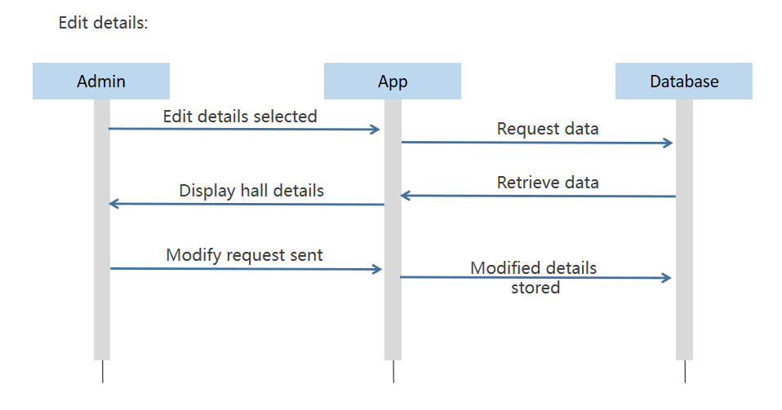
Sequence diagram

Slide 11
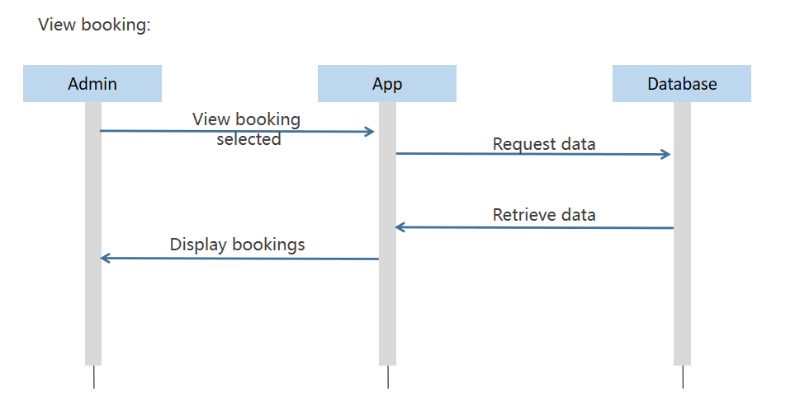
Sequence diagram

Slide 12
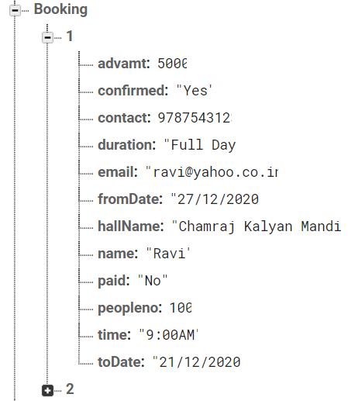
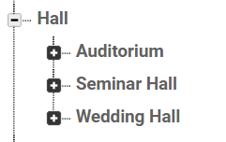
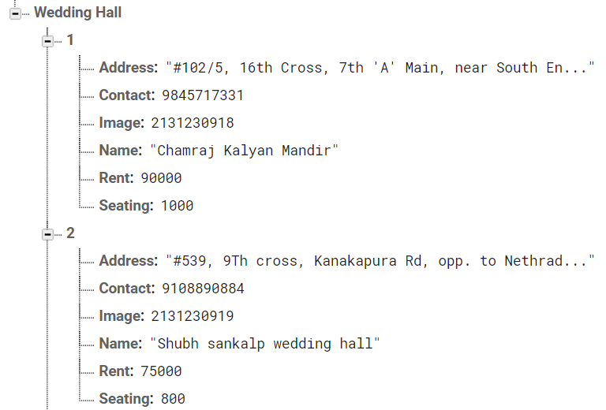
Database
The Firebase Realtime Database is a cloud-hosted database. Data is stored as JSON and synchronized in realtime to every connected client.

Slide 13
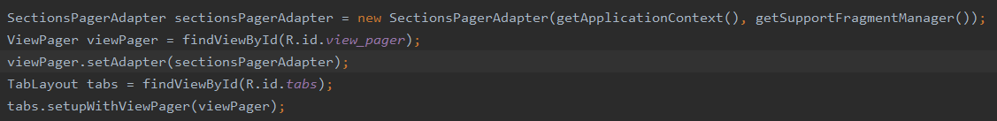
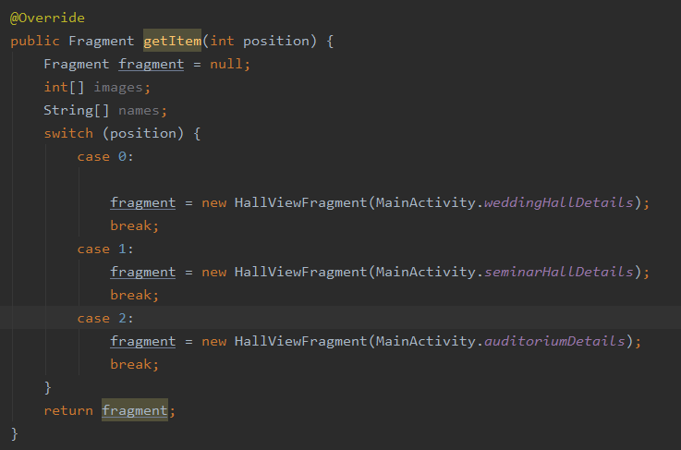
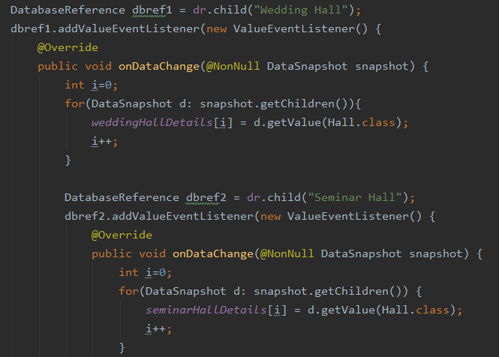
Code Snippets
User UI

Slide 14
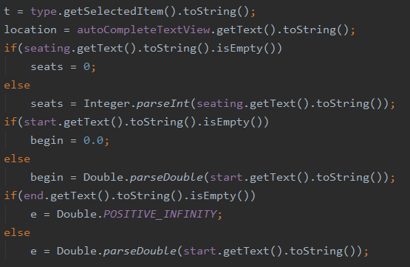
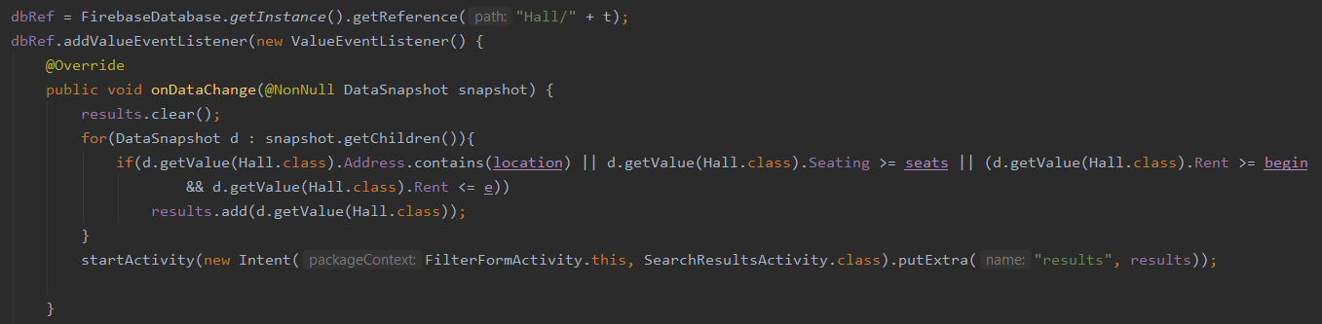
Retrieving Search Results

Slide 15
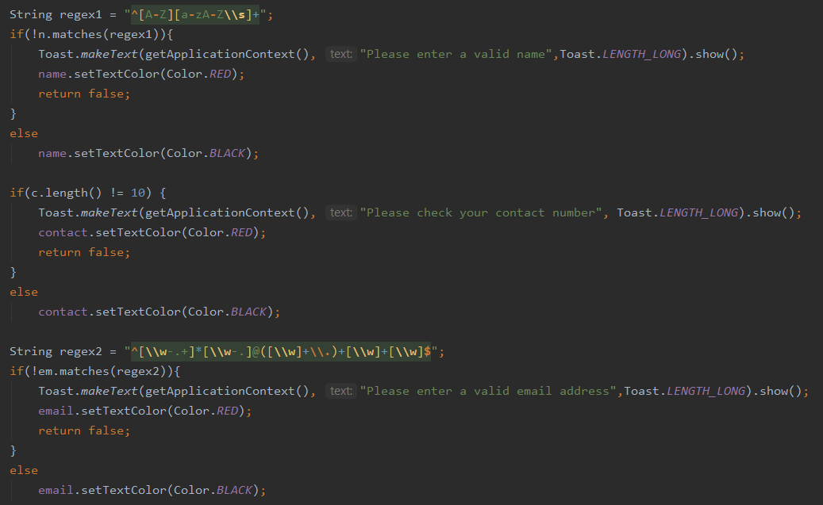
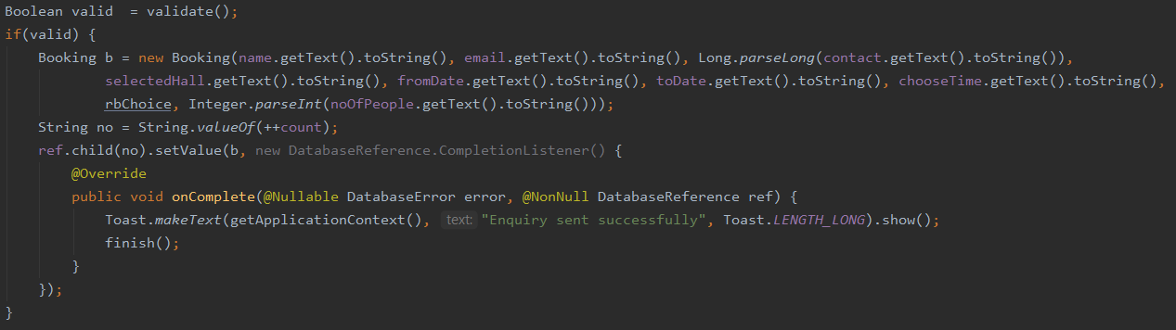
Validating form entries

Slide 16
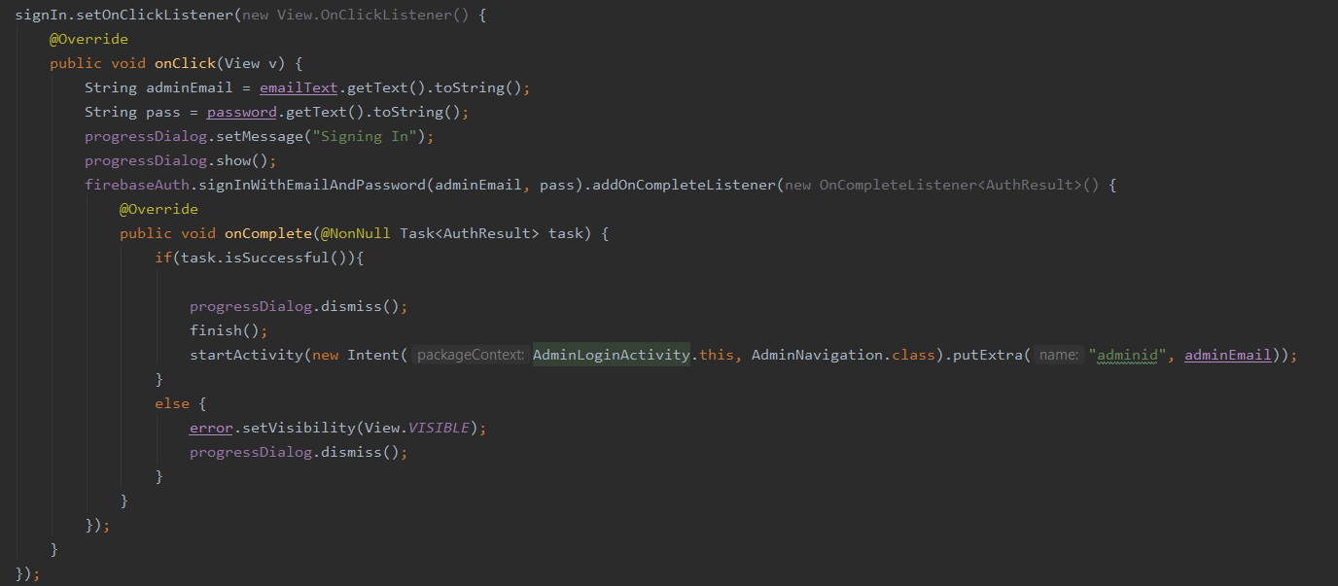
Admin Login

Slide 17
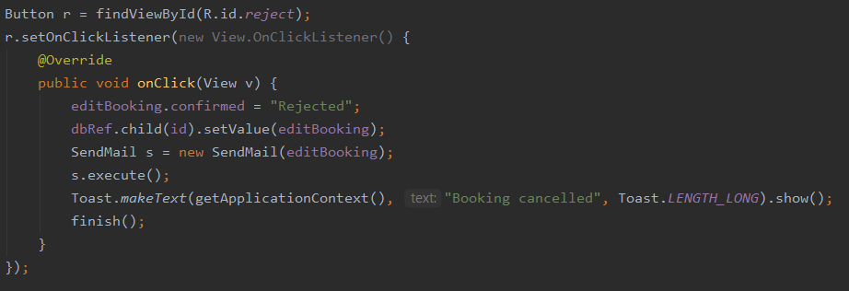
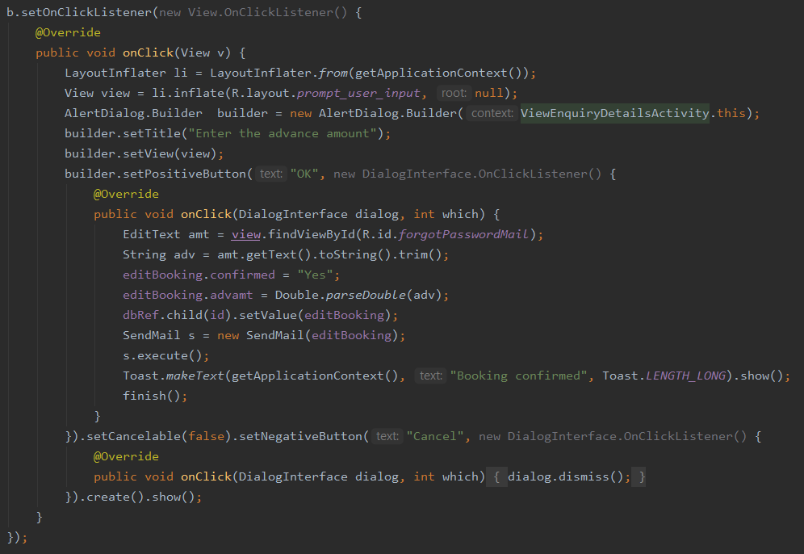
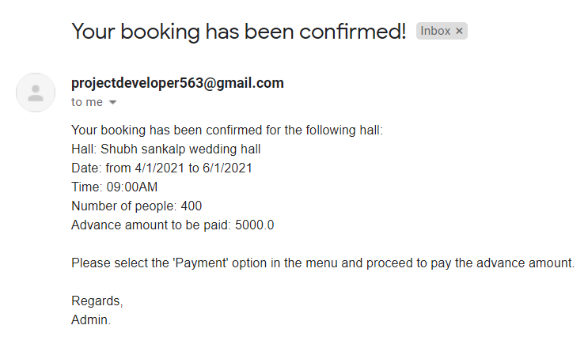
Confirming/Deleting bookings

Slide 18
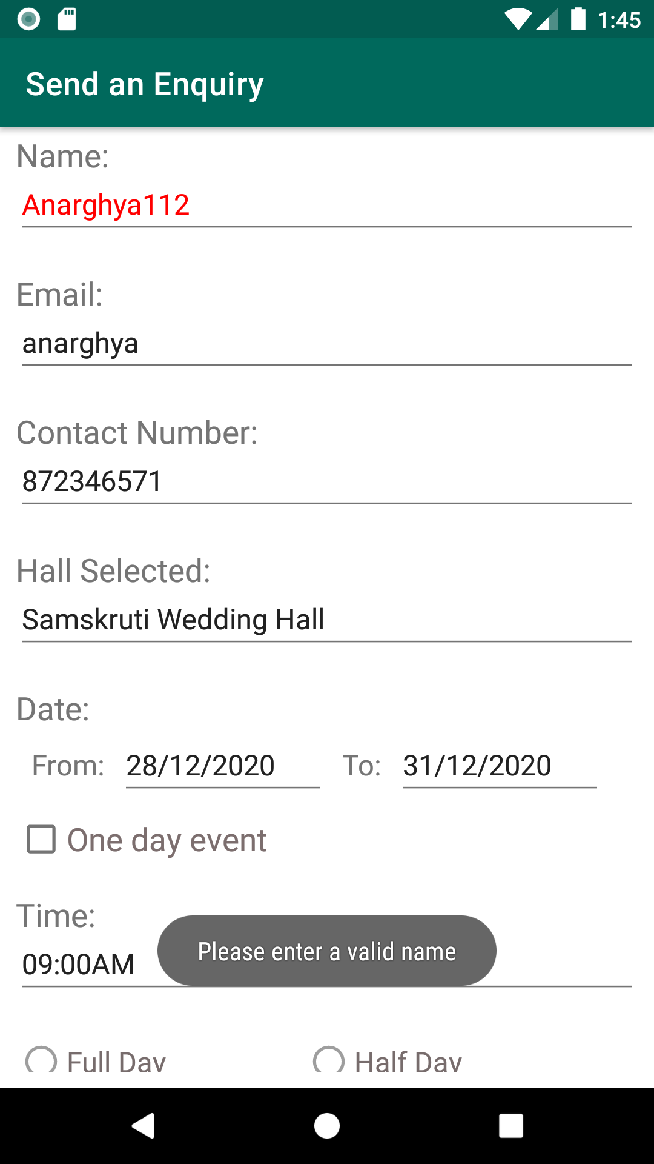
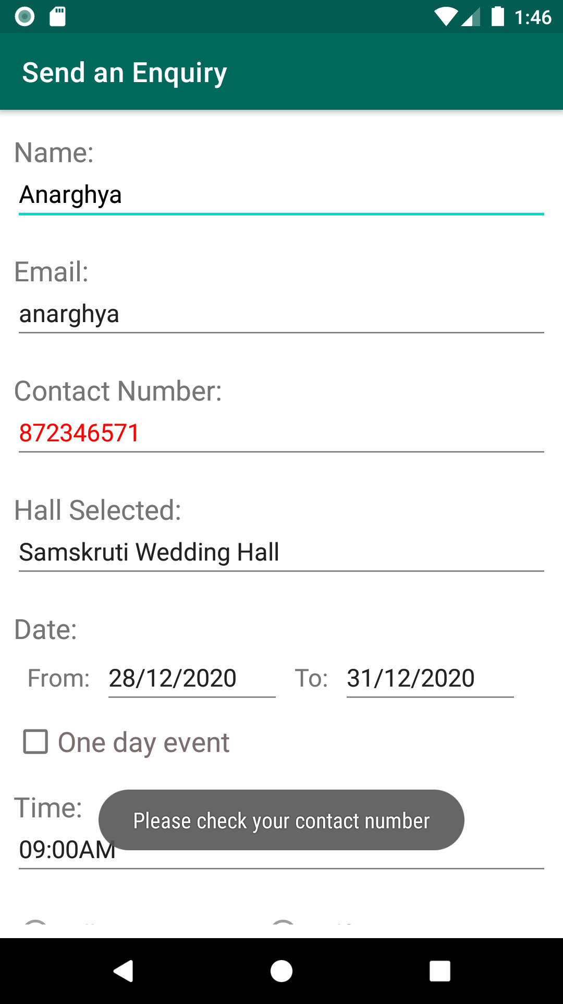
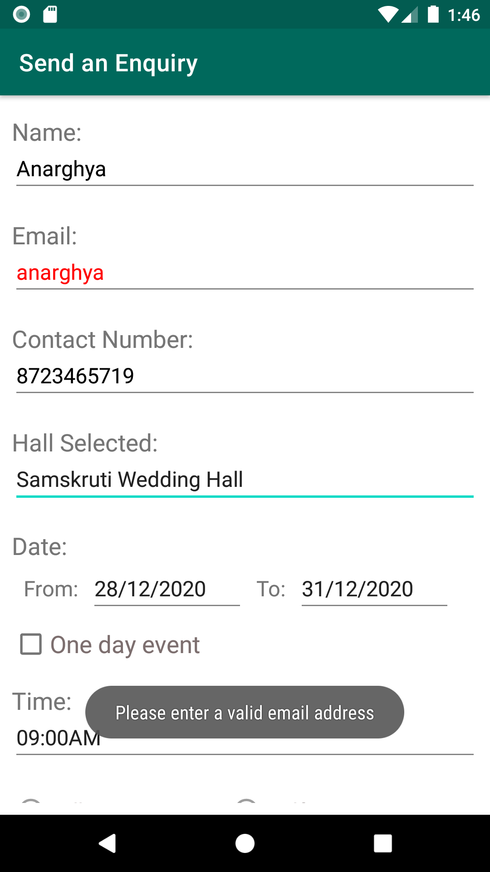
TEST CASES

Slide 19
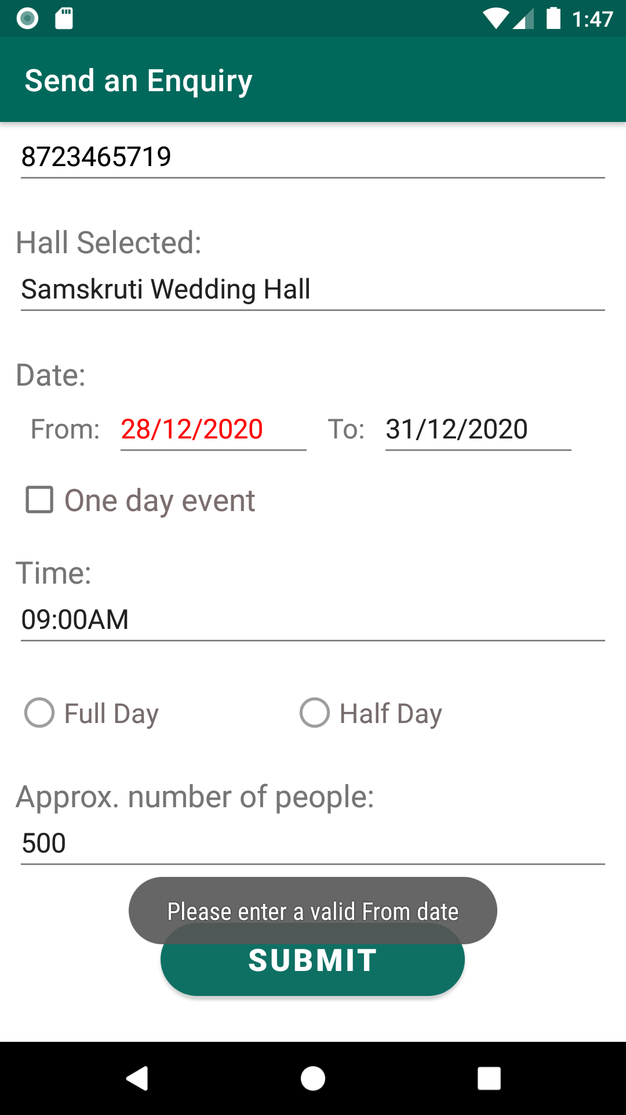
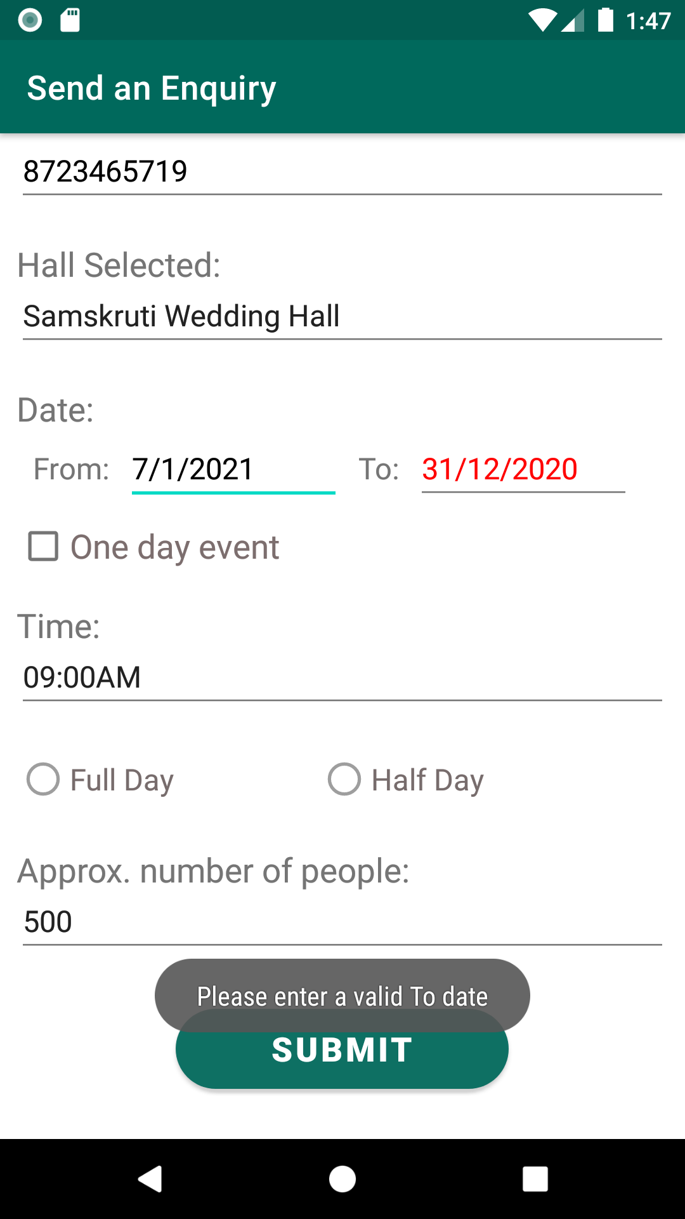
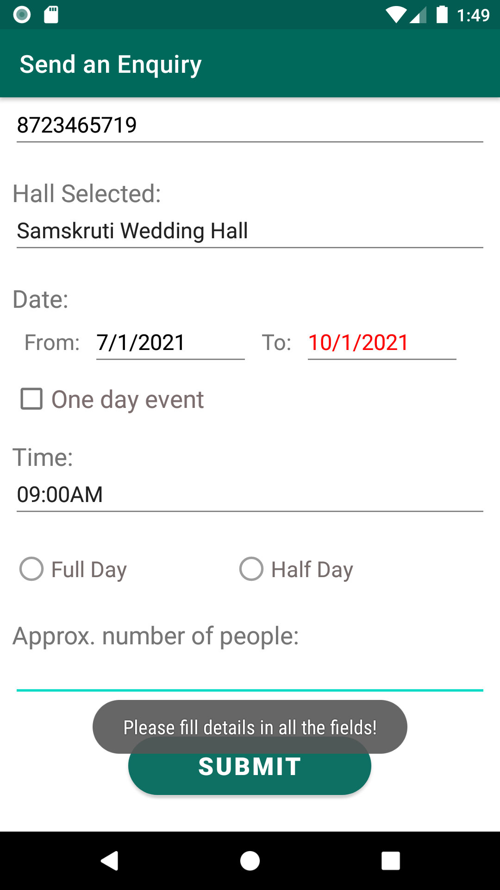

Slide 20
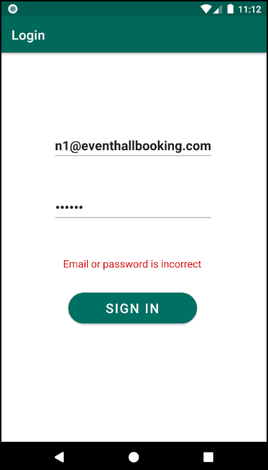
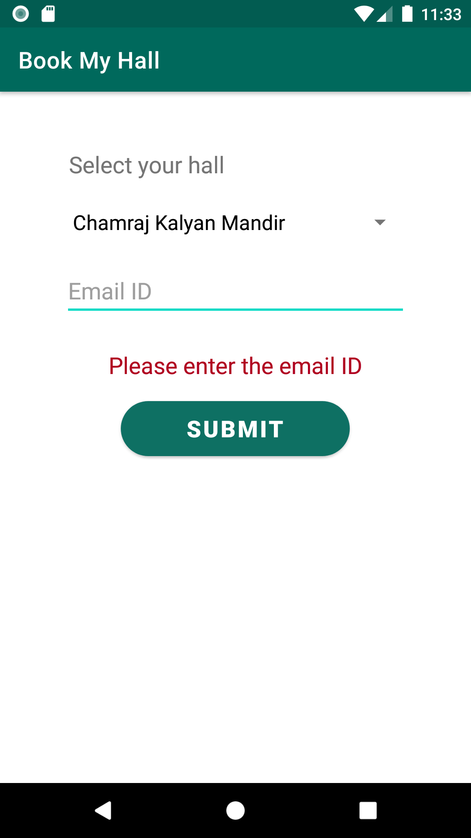

Slide 21
THANK YOU

